Slide 1
DR.BINO
Associate Prof.
DEPT OF SURGERY

Slide 2
HAND
&
FOOT infections
Dr.A.Bino, MD
DEPT OF SURGERY
SKHMC

Slide 3
HAND
SURGICAL ANATOMY OF THE HAND
a) Flexor Retinaculum
It extends medially from pisiform and hook of hamate,
laterally to scaphoid tubercle and trapezium crest as a
strong fibrous band so as to bridge carpus to create a
carpal tunnel.
Ulnar nerve and vessels, palmar cutaneous branches of
median and ulnar nerves, palmaris longus muscle are
superficial to the carpal tunnel.

Slide 4
Median nerve, tendons of flexor digitorum superficialis,
profundus and pollicis longus, radial and ulnar bursa are
deep to flexor retinaculum.
b) Palmar Aponeurosis
It is a thickened, modified deep fascia in the palm with its apex pointing proximally and base distally and gets divided into 4 parts.

Slide 5
Flexor retinaculum and Palmar Aponeurosis

Slide 6
Blood supply of the hand
Superficial palmar arch is formed by
ulnar artery.
Deep palmar arch is formed by
radial artery.

Slide 7
Muscles of the hand.
Thenar muscles - Abductor pollicis brevis, flexor pollicis
brevis, opponens pollicis and adductor pollicis.
Hypothenar muscles - Palmaris brevis, abductor digiti
minimi, flexor digiti minimi and opponens digiti
minimi.
Lumbricals are four in number - named lateral to
medial.
Four palmar interossei.
Four dorsal interossei.

Slide 8
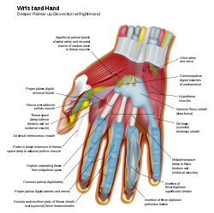

Slide 9
Nerve supply
Abductor pollicis brevis, flexor pollicis
brevis, opponens pollicis and 1st and 2nd
lumbricals are supplied by median nerve.
Rest of the muscles in hand are supplied
by ulnar nerve.

Slide 10
HAND INFECTIONS
Hand – neurovascular bundles, muscles,
bones and ligaments.
Infections may be due to minor injuries
or blood borne.

Slide 11
PRECIPITATING CAUSES
Diabetes,
Immunosupression
Trauma
HIV infection
Steroid therapy
Vascular diseases

Slide 12
COMMON ORGANISMS
Staphylococcus aureus
Streptococcus
Gram – negative organisms like E.coli,
klebsiella, pseudomonas.
rarelyfungal and viral infections.

Slide 13
GENERAL FEATURES OF HAND INFECTION.
Infection spreads very faster.
Causes oedema over the dorsum of hand due to lax skin
and more lymphatic network over the volar aspect and it
like frog hand.
Restricted movements of fingers and hand.
Hand functions are totally lost.
Severe pain and tenderness with fever.
Tender palpable of axillary lymph nodes are often
present.

Slide 14
DIFFERENT TYPES OF HAND INFECTIONS
Acute paronychia.
Chronic paronychia
Terminal pulp space
infection.
Subungual infection
Web space infection
Mid palmar space infection
Thenar space infection
Deep palmar abscess.
Acute suppurative
tenosynovitis
Chronic tenosynovitis
Lymphangitis of hand
Arthritis of hand joints.
Subcuticular abscess.

Slide 15
Deep Palmar Space infection and Lymphangitis of Hands

Slide 16
Midpalmar space infection And Thenar space infection

Slide 17
Web space infection And Collar stud Abscess

Slide 18
Hand infection can be superficial or deep and also it can be localized or spreading.

Slide 20
ACUTE PARONYCHIA
Most common hand infection.
Occurs in subcuticular area under eponychium.
cause-injury
Suppuration very rapid
It tracks around the skin margin and spreads under
the nail causing hang nail or floating nail
Organisms- staphylococcus and streptococcus.

Slide 21
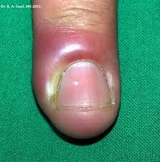

Slide 22
CLINICAL FEATURES
Severe throbbing pain and tenderness with visible pus under the nail root .

Slide 23
TREATMENT
Incision and drainage, removing
the nail.
pus sent for culture and sensitivity.

Slide 24
CHRONIC PARONYCHIA
It is commonly due to the fungal infection – due to candida infection commonly

Slide 25
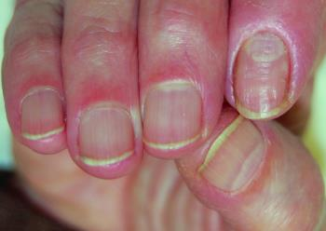

Slide 26
FEATURES
Common in females.
Itching in nail bed
Pain and discharge
secondary bacterial infection is common
Removal of nail in chronic cases.

Slide 27
APICAL SUBUNGUAL INFECTION
It is the infection of the space between subungual
epithelium and periosteum.
Occurs after minor trauma or formation of subungual
haematoma.
drainage with ‘V’ incision.

Slide 28
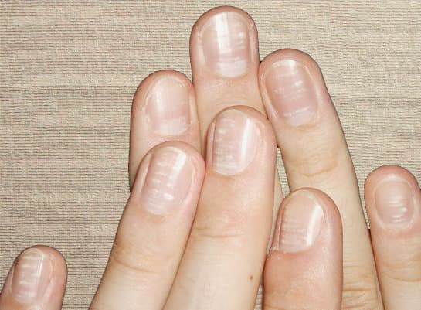

Slide 29
TERMINAL SPACE INFECTION
Second most common hand infection.
Thumb and index are commonly affected.
Usually by a minor injury like Finger prick

Slide 30
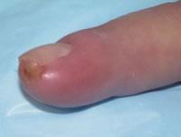

Slide 31
SURGICAL ANATOMY
Terminal pulp space contains fat and separated by septae
which is attached from periosteum of terminal phalanx to
the skin.
Terminal space is a closed compartment pressure
increases due to infection which compresss the terminal
artery leading to thrombosis resulting in osteomyelitis of
terminal phalanx

Slide 32
BACTERIA
Staphylococcus
Streptococcus.

Slide 33
CLINICAL FEATURES
Pain, tenderness, swelling of terminal phalanx,
Fever,
Tender axillary lymph nodes.
suppuration may leads to collar stud abscess.

